Slide 1
Renaissance
Italian Proto-Renaissance with reference to
Giotto (1267-1337)
History of Western Art
BFA-II (Visual Arts)
Course Incharge: Ms. Farah Khan
Institute of Design & Visual Arts (LCWU)

Slide 2
Renaissance
https://youtu.be/UsKSB-aT3ys,
https://youtu.be/xf2G2Il8crw,
https://youtu.be/0L_R804ZFHQ
https://youtu.be/Uhd-uwFonog Video link for the age of Renaissance
The literal meaning of Renaissance is Rebirth. Rebirth of Knowledge (Classical Knowledge of Greek and Roman)
According to Webster Dictionary: It was a transitional movement in Europe between medieval and modern times beginning in the 14th century in Italy, lasting into the 17th century, and marked by a humanistic revival of classical influence expressed in a flowering of the arts and literature and by the beginnings of modern science.
The Renaissance was a cultural movement which saw a flowering of education, literature, art and sciences. The Renaissance saw an inflow of new ideas and new practices and left a profound cultural legacy.
The Renaissance was enabled by scientific discoveries, most notably, the development of the printing press by J. Gutenberg, which allowed the mass production of books. The heart of the Renaissance is considered to have started in Florence during the early 14th Century. This was helped by financial and cultural support from the dominant Medici family, and later from the Vatican.

Slide 3
Renaissance
The Renaissance had a passion for art. Commissions came from kings, popes, princes, nobles, and lowborn mercenary captains.
Cities wanted their council halls decorated with huge murals, frescoes, and tapestries depicting great civic moments. Monasteries commissioned artists to paint frescoes in cells and refectories that would inspire monks to greater devotion. And civic, dynastic, and religious leaders hired architects to erect buildings at enormous expense to beautify the city or to serve as semipublic residences for leaders. Such art was designed to celebrate and impress.
A remarkable feature of Renaissance art was the heightened interaction between patron and artist. Patrons such as Lorenzo de’ Medici (1449–1492) of Florence and popes Julius II (reigned 1503–1513) and Leo X (reigned 1513–1521) were active and enlightened patrons.
Major art forms, such as paintings, sculptures, and buildings, have attracted the most attention, but works in the minor arts, including furniture, silver and gold objects, small metal works, table decorations, household objects, colorful ceramics, candlesticks, and priestly vestments were also produced in great abundance.

Slide 4
Two major divisions of the Renaissance
1. Italian Renaissance
i) Knowledge was the main key. It focused on the city states of the Northern Italy and Rome
2. Northern Renaissance
It focused on the regions of Northern Europe like England, Spain, France, Netherlands and Germanic Regions (Roman Empire)
Major Themes of the Renaissance
i) Humanism:
According to Cambridge Dictionary humanism is a system of thought and reasoning based on human values and interests, often without accepting the beliefs of religion. It focused on human potential, human progress, and the expansion of human knowledge.
ii) Secularism:
a) Separation of religious institutions from state institutions and a public sphere where religion may participate, but not dominate.
b) Freedom to practice one’s faith or belief. and c) Equality .
iii) Individualism: A social theory favoring freedom of action for individuals over collective or state control

Slide 5
Late 13th and early 14th century with reference to Giotto
In the late 13th and early 14th centuries, Europe was experiencing a period of exceptional growth. The population was steadily increasing, trade flourished, cities were expanding, and new churches and civic buildings were going up everywhere. Central Italy at that time was the scene of a renewal in Western art, of which the outstanding figure was Giotto di Bondone.
He was a pupil of Cimabue and worked with major sculptors and painters including Arnolfo di Cambio, Duccio di Buoninsegna, Pietro Cavallini and Simone Martini. Giotto worked for popes and kings, and especially for the new religious orders which had sprung up in the 13th century, the Franciscans and Dominicans.
(https://youtu.be/zSAabnzWWiU video link)
Giotto di Bondone simply known as Giotto is considered to be the earliest link for revolutionizing Italian painting. Giotto is acclaimed as the first Renaissance painter because he created expressive, anatomically convincing figures in clearly defined three-dimensional spaces. Both his contemporaries and his successors hailed him as the man who brought about the rebirth of painting and helped make his native Florence the center of Italian art.

Slide 6
Giotto di Bondone (1267-1337)
After centuries of Byzantine influence, the figures painted by Giotto were people of flesh and blood, depicted in familiar settings.
In the middle ages, painters and sculptors were regarded simply as craftsmen of no great social standing. Giotto was one of the first artists about whom significant factual information was recorded in history. This was due also to the fact that he came from the proud and powerful city of Florence, whose rulers wanted to record its history for generations to come.
However, Giotto had predominant exceptional abilities on the bases of which he was chosen by Cimabue. Giotto was born in Florence, in 1267. His father Bondone grew crops and raised sheep. In the early chroniclers it has been recorded, that at the age of 10, one day after looking at the sheep, Giotto was drawing of them with a sharp stone on a flat piece of rock. Cimabue, the great painter of the time, happened to be passing that way and, surprised by the child’s ability, convinced his father to let him join in his workshop. The reality is somewhat different, it is known fact that during Giotto’s boyhood, many country people were leaving the land and moving into Florence. Bondone was one of them, in the Tuscan capital, he first sent his son to work for the wool guild. Then, aware of his talents, he placed him in Cimabue’s workshop.

Slide 7
Giotto with reference to his Work
Cimabue who painted in a manner that is clearly medieval, having aspects of both the Byzantine and the Gothic. Cimabue in the late 13th century, received acknowledgment after reviving the art of painting, departing from the Byzantine style to show people and things in a more realistic way. Cimabue was an innovator in representing human facial expressions. Giotto followed his foot steps and he also used to accompany Cimabue on his long trips to Rome and Assisi.
However ahead from his master, Giotto’s monumentality of forms and clarity of compositions was revolutionary in style. As well as his revolutionary way of painting figures which are solidly three-dimensional, have faces and gestures that are based on close observation and are clothed, not in swirling formalized drapery, but in garments that hang naturally and have form and weight.
He also took bold steps in foreshortening and with having characters face inwards, with their backs towards the observer, creating the illusion of space.
Giotto had exceptional drawing skills, in the 16th century, Giorgio Vasari wrote that Giotto was able to draw a perfectly round “O” freehand, In fact, “as round as Giotto’s ‘O’” became a proverbial expression.

Slide 8
Giotto with reference to his Work
Stories about Giotto’s skill and his relationship with Cimabue were common in the 14th century. According to one story, when Cimabue was out of the workshop one day, Giotto painted a fly on the nose of a figure Cimabue had been working on. When the master returned, he is said to have tried several times to brush away the fly, so realistically was it drawn.
Dante, the great Florentine poet and Giotto’s contemporary, wrote some years later that Cimabue had been the greatest artist until the arrival of Giotto. Cimabue also helped Giotto for setting up a workshop of his own when he was between the ages of twenty-two to twenty-five.
His first important commission was for a large crucifix for the Dominican Church of Santa Maria Novella in Florence. Cimabue recommended his pupil for this commissioned project which was to hang in the center of the nave.
Earlier in his career, Giotto received recognition as a result of getting commissions from important patrons, that led him to frequent journeys up and down Italy. In central Italy, he undertook work in Assisi and Rome; in the south, in Naples; in the north, in Milan, Rimini, Ravenna and Padua.

Slide 9
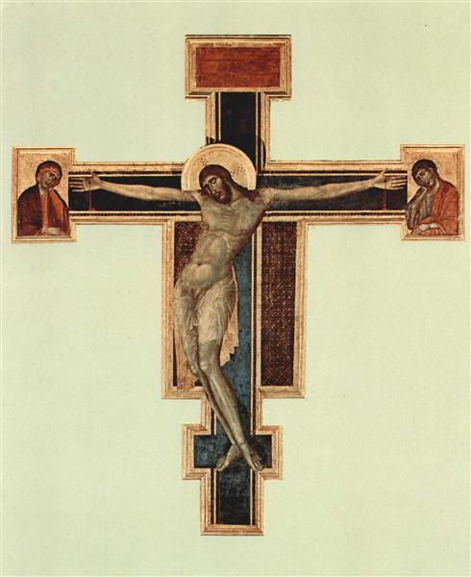
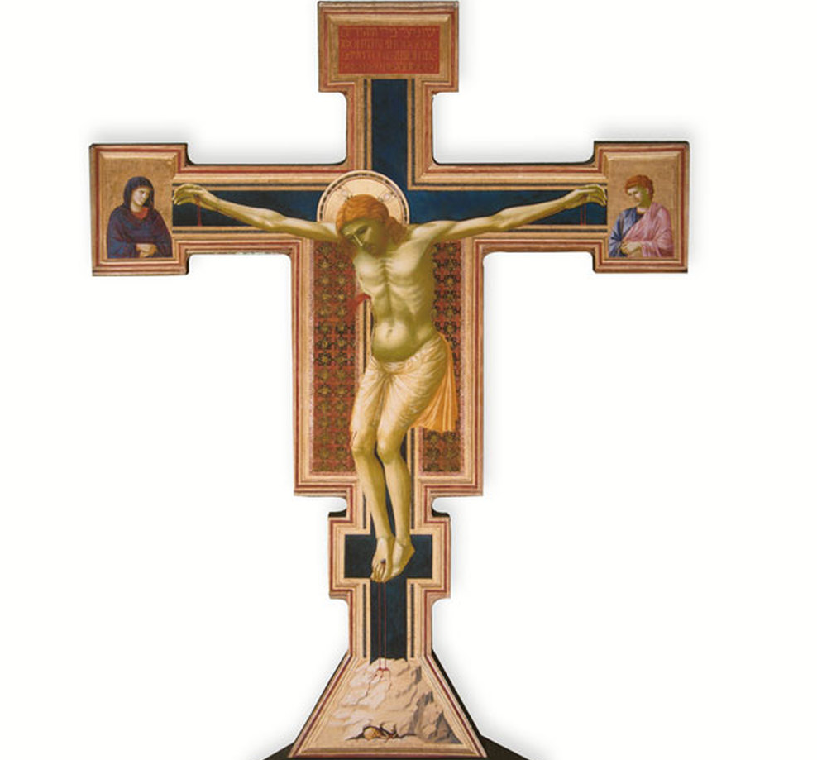
Crucifixes
Crucifix by Cimabue (c. 1280)
Crucifix by Giotto (c. 1288-1289)

Slide 10
Giotto with reference to his Work
Sometime around 1290, Giotto came to Assisi to paint the life story of St Francis. He has probably been there before, while apprenticed to Cimabue, and had an opportunity to familiarize himself with the most recent trends in painting. Some scholars believe that Giotto had already painted some of the biblical scenes on the higher sections of wall, before he came to work on the St Francis cycle. But the artist reached his full maturity in his frescos of St Francis, telling the episodes of the life of the Saint with a new concern for earthy reality. Giotto was to return to Assisi again in the second decade of the 14th century. Despite a lack of documentary evidence, many critics agree that the overall design for the chapel dedicated to St Mary Magdalene in the Lower Church is the work of Giotto himself, though executed by a large team of assistants.
https://youtu.be/MQct5EFQ9x8, https://youtu.be/JZbpV_3osQg (video links for St Francis church paintings by Giotto)
Each panel in the St Francis cycle depicts a single event in the life of the saint and is complete in itself. Francis appears in 26 of the 28 panels, he is shown in profile or full face, standing, kneeling, or lying down, alive or dead, on earth or in heaven. He can be recognized with a halo that indicates his holiness.

Slide 11
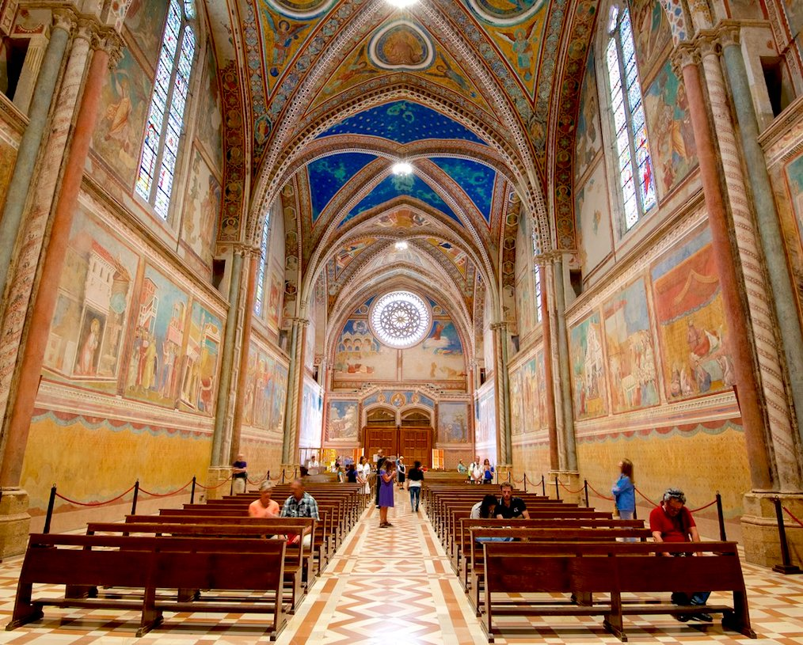
Basilica of St Francis of Assisi

Slide 12
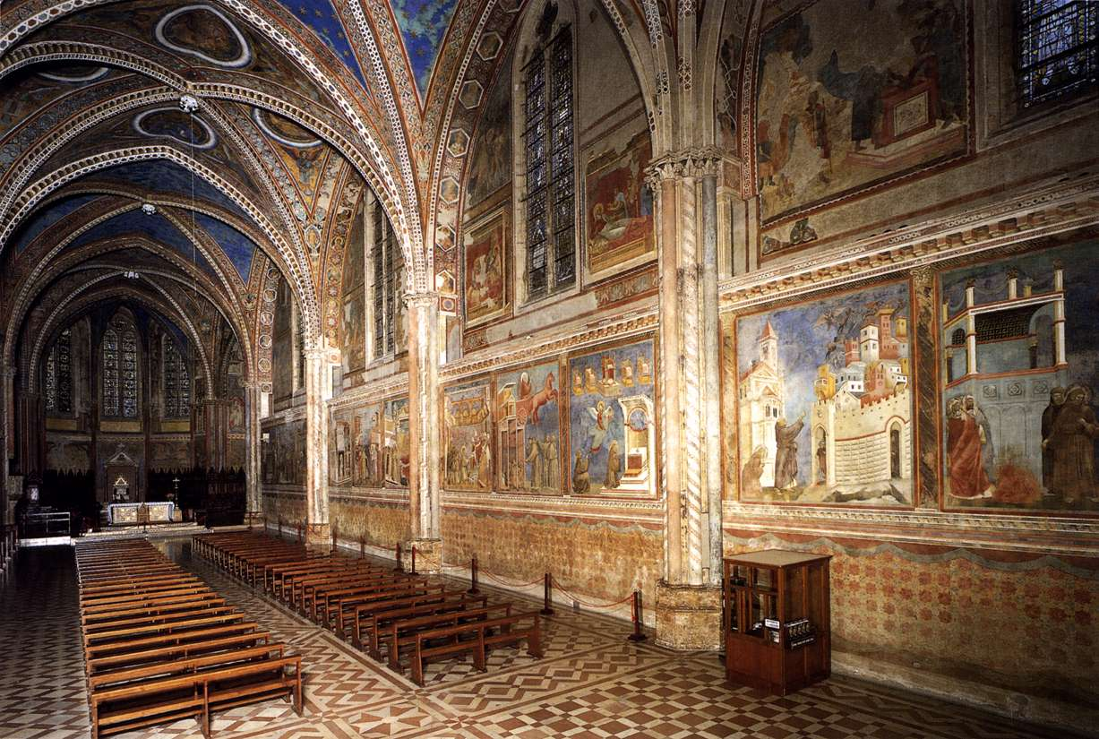
Basilica of St Francis of Assisi

Slide 13
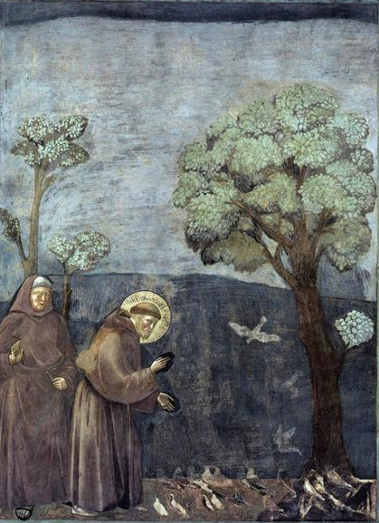
Francis preaches to the birds (1297-1299)

Slide 14
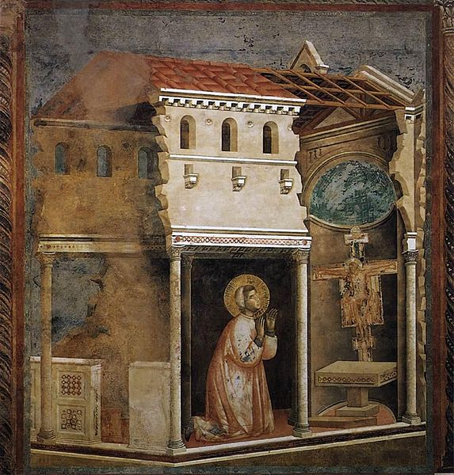
Miracle of the Crucifix (1297-1299)

Slide 15
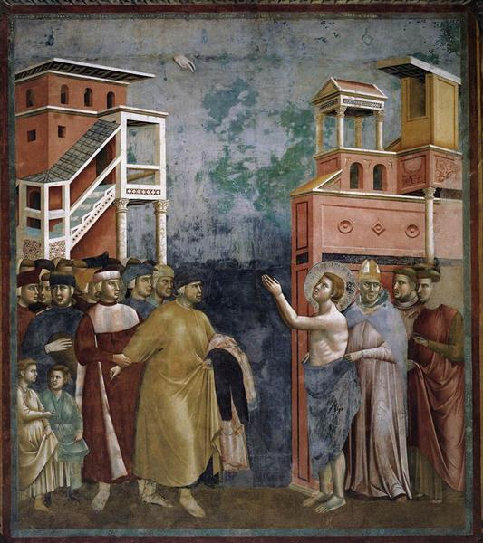
Francis renounces his earthy possessions (1297-1299)

Slide 16
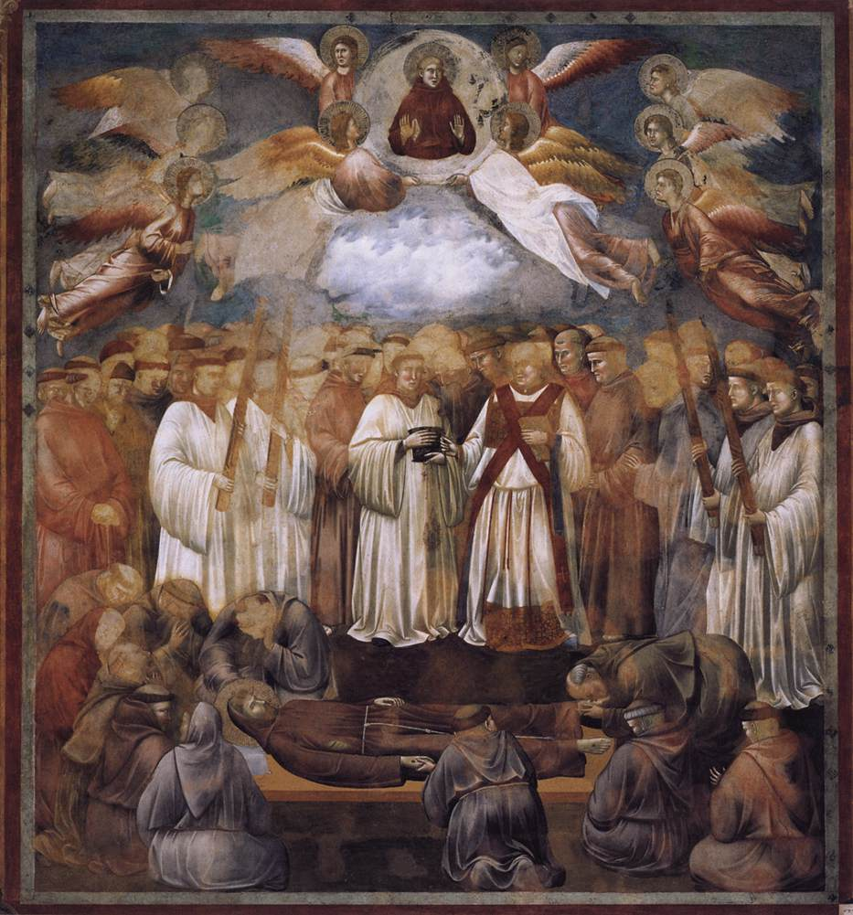
The death of St Francis (1297-1299)

Slide 17
Characteristic features of Giotto’s Work
Emphasis on form
Feeling of weight
Illusion of space
Perspective
Naturalism
Clarity of composition
Three-dimensional quality
Inclusion of expressions
Close observation of nature
Draped figures with volume
Addition of foreshortening
Humanistic approach
Focused on anatomy
Balance

Slide 18
Giotto with reference to his Work
Some modern historians believe that, while living at Assisi and working on the fresco cycle of the life of St Francis, Giotto made several trips to Rome. His purpose would have been to broaden his outlook by studying classical painting and the works of the Roman artist Pietro Cavallini, who was probably a strong influence on Giotto.
In around 1320, he painted the stefaneschi alter-piece, or triptych, for the Roman Cardinal Stefaneschi. It is considered to be one of the great works of his mature career.
Giotto was commissioned to paint frescos in the Arena Chapel in Padua. The concept of sin, judgement, and punishment were central to late medieval painting. Christians believed that, at the end of history, Christ would return to earth, the dead would rise from their graves, and there would be a final reckoning. After the year 1000, the Church made the Last Judgement a central theme of its preaching.
The fresco cycle in the Arena Chapel at Padua is considered to be Giotto’s greatest work in terms of complexity and artistic maturity. It was commissioned to him in 1302 by Enrico Scrovegni with focus on ‘The Last Judgement’.

Slide 19
Giotto with reference to his Work
The Chapel is of modest proportions, roughly 13 metres long, 8.5 metres wide and 13 metres high. It is very simple in design, a rectangular structure of red brick, its roof a single barrel vault. But the interior walls are decorated from floor to ceiling with Giotto’s most famous fresco cycle. Arranged in three horizontal bands, the paintings depict the story of Joachim and Anna (Mary’s parents), the life of the Virgin, and the life of Christ, kings and members of the tribe of Judah, prophets (in the medallions on the ceiling), and of course the great last judgement, which takes up the whole of the entrance wall. The cycle is a magnificent demonstration of Giotto’s mastery of space and color.

Slide 20
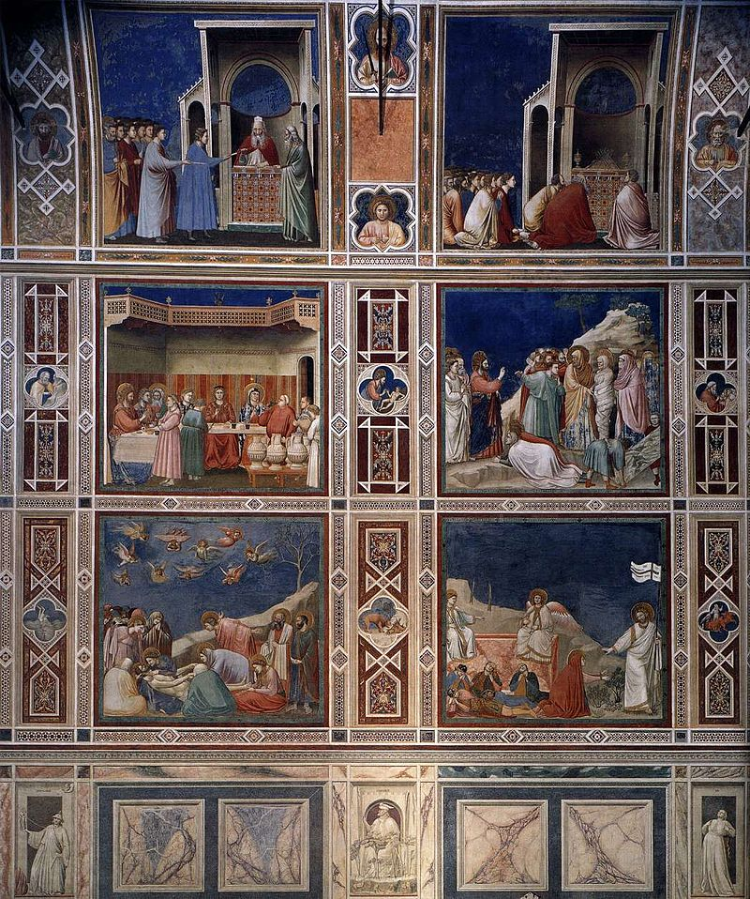
Interior of Arena Chapel

Slide 21
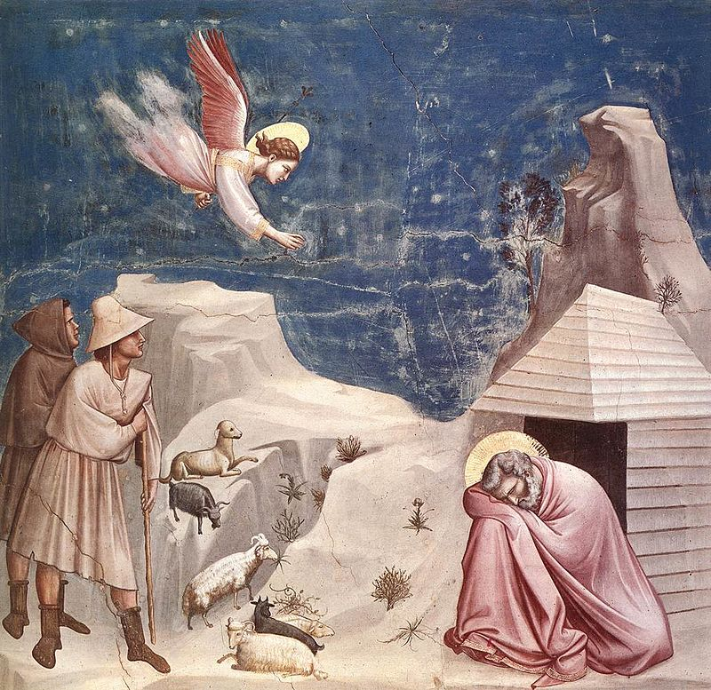
The dream of Joachim (1303)

Slide 22
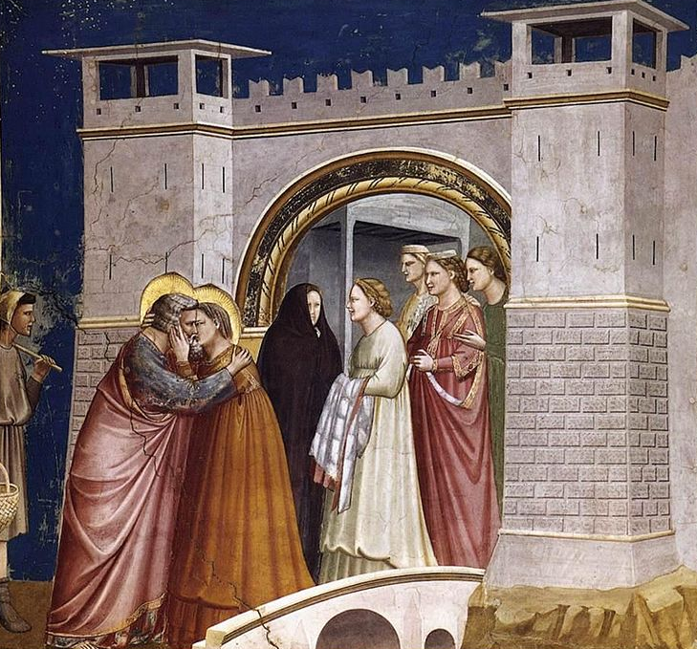
Meeting at the Golden Gate (1306)

Slide 23
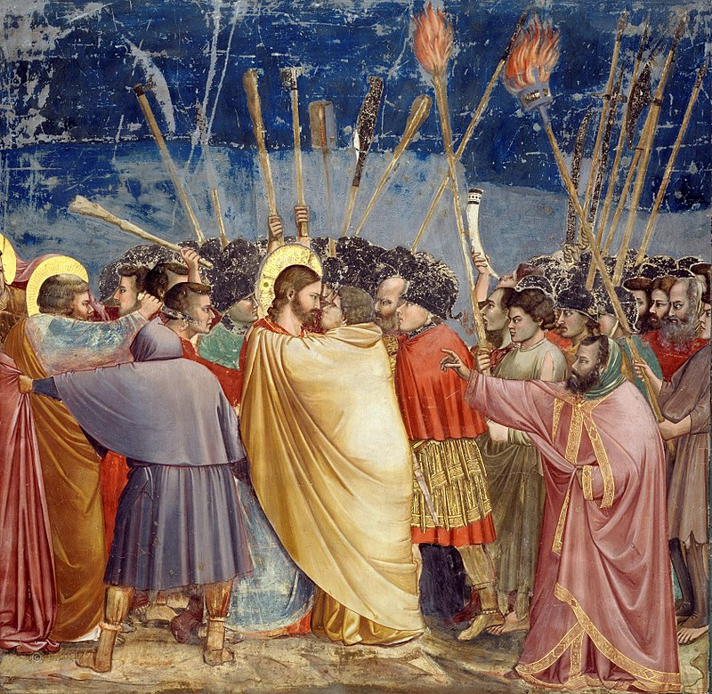
Kiss of Judas/Betrayal of Christ (1304-6)

Slide 24
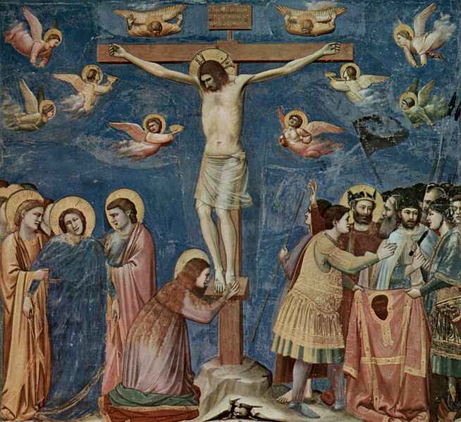
The Crucifixion

Slide 25
“The Crucifixion of Giotto,” writes Bernadette Neipp, “is the expression of Franciscan spirituality in the gentleness of the expression of pain in Christ’s face in this fresco. He is not wearing the crown of thorns; a halo shines behind his head … The tragic aspect is expressed by those who surround Christ: the angels that fly weeping around the Crucified One, Mary Magdalene at the foot of the cross, Mary supported by John and another woman … The entire scene stands out before a sky of deep blue – the color of faith. The emphasis is on the sacrificial meaning of Christ’s death – the angels collect the blood that flows from his wounds. In his approach to the depiction of the crucifixion, Giotto had a huge influence on those who came after him, especially when it came to composition.”

Slide 26
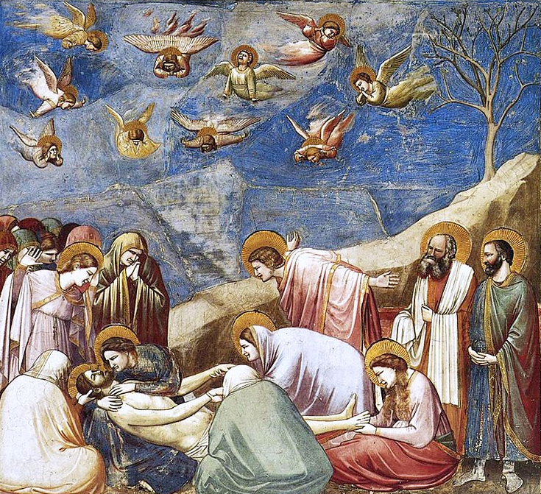
Lamentation

Slide 27
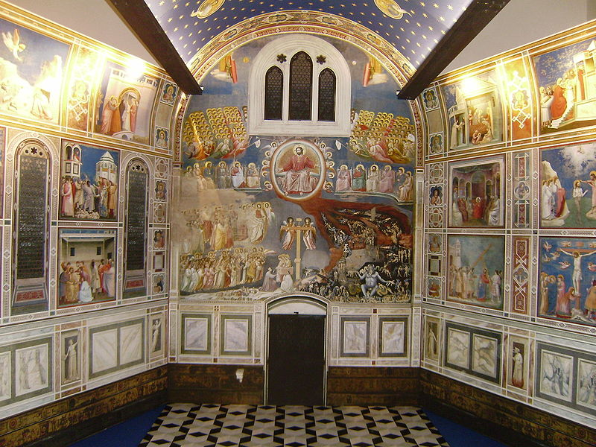
The Last Judgement

Slide 28
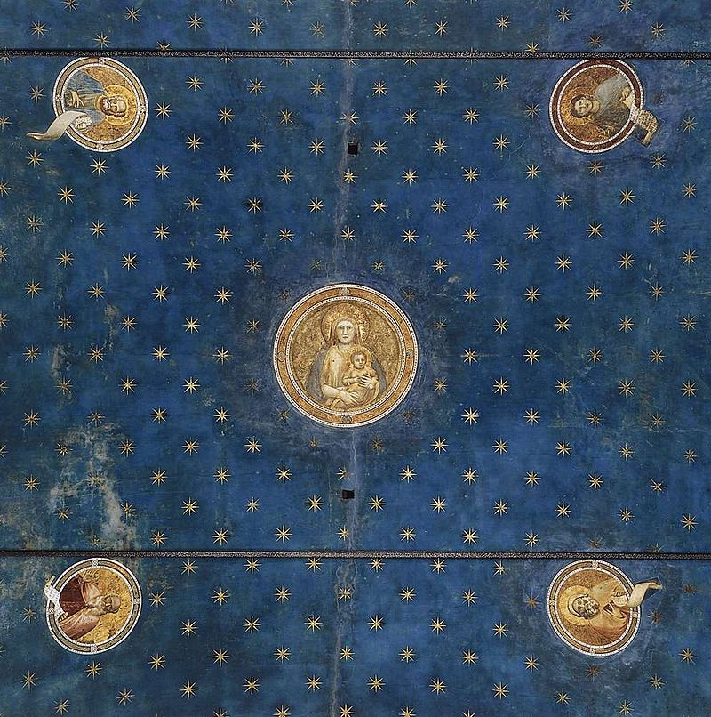
Ceiling with medallions

Slide 29
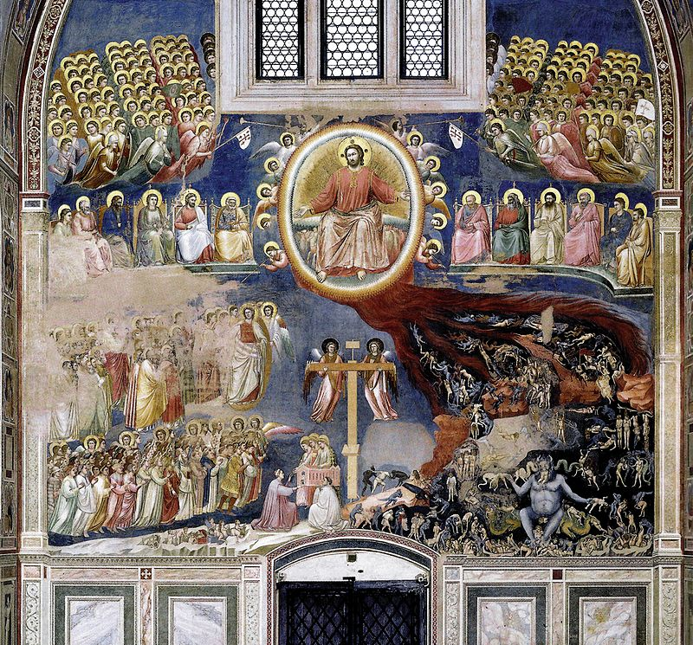
The Last Judgement

Slide 30
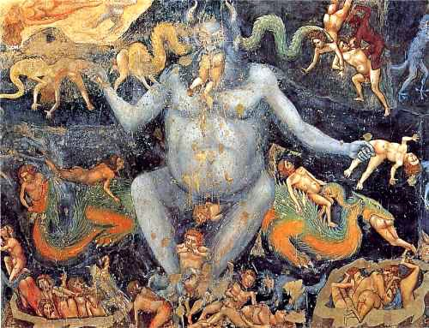
The Last Judgement (close-up study)

Slide 31
Giotto with reference to his Work
https://youtu.be/47QgqdeSi0U,
https://youtu.be/I356lV1v8Bc,
https://youtu.be/RbBQN0Wt_wY,
https://youtu.be/6z_Kjsn8VLI,
https://youtu.be/be9rz_HOnXI (Video links for Arena Chapel)

Slide 32
Conclusion
Many of the greatest artists-Leonardo or Michelangelo, Rembrandt or Goya, for instance-a are not regarded as having started a school of painting. Giotto did.
He directly influenced the work of his pupils, many of whom became major artists in their own right, and he was instrumental in determining the style of following generations. By the time of Giotto’s death, there had been a radical change in the prevailing style of painting. His work spelled an end to the stylization of Byzantine art. He introduced naturalism in art, in the representation of people and objects with real depth, and this opened the way for the Renaissance. The work of Giotto and his followers in the 14th century therefore marks a major turning point in the history of European art.

